Slide 1
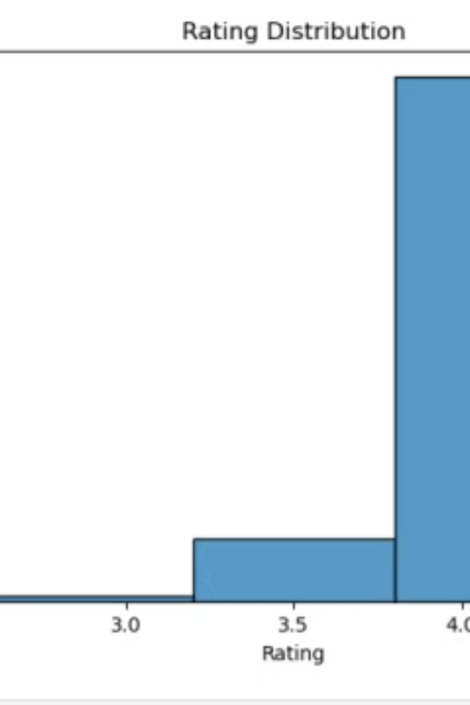

E-Commerce Product Recommendation System
This project focuses on developing an e-commerce product recommendation system using data analytics and machine learning algorithms. The dataset contains 1465 entries and 16 columns, primarily focused on product information, user reviews, and pricing data.
by Radhika Ambulkar

Slide 2

Data Preprocessing
1
Price Conversion
2
Missing Values
Convert price columns (discounted_price, actual_price) into numerical values by removing currency symbols.
Handle missing values in columns like rating_count, which may have missing data.
3
Rating Conversion
4
Interaction Matrix
Convert ratings to float data type.
Create an interaction matrix for users and products using user_id and product_id.

Slide 3
Exploratory Data Analysis (EDA)
Product Popularity
User Interaction
Rating Distribution
Analyze product popularity based on sales trends and rating counts.
Understand user interaction with products based on reviews and ratings.
Analyze the distribution of product ratings to understand customer sentiment.

Slide 4
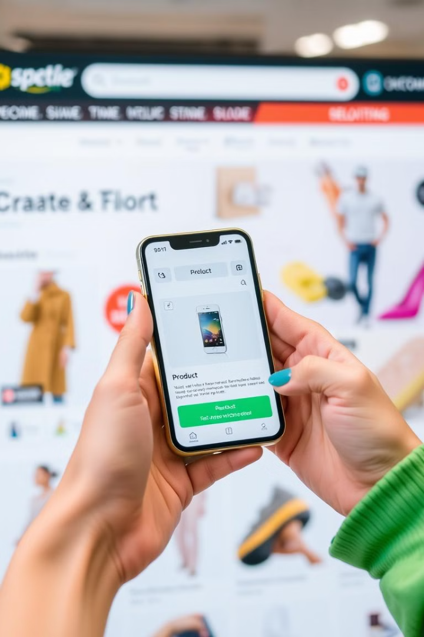
Recommendation System Approaches
Collaborative Filtering
Recommend products based on user-product interactions using user_id, product_id, and ratings.
Content-Based Filtering
Recommend products based on product attributes like category and about_product.

Slide 5



Model Training
Collaborative Filtering
Train the model using algorithms like Matrix Factorization (SVD) or KNN.
Content-Based Filtering
Use similarity measures like TF-IDF or Cosine Similarity on product descriptions.

Slide 6




Evaluation
Precision@K
Evaluate the system's recommendations using metrics like Precision@K.
Recall@K
Evaluate the system's recommendations using metrics like Recall@K.
A/B Testing
A/B test the recommendations in a real environment to assess performance.

Slide 7

Collaborative Filtering Implementation
Step 1
Create a user-item interaction matrix.
Step 2
Compute cosine similarity between users.
Step 3
Recommend products based on similar users' preferences.

Slide 8

Content-Based Filtering Implementation
TF-IDF
Recommendation
Use TF-IDF on product descriptions to create a vector representation.
Recommend products similar to the target product based on cosine similarity.
1
2
3
Cosine Similarity
Compute cosine similarity between products based on their descriptions.

Slide 9
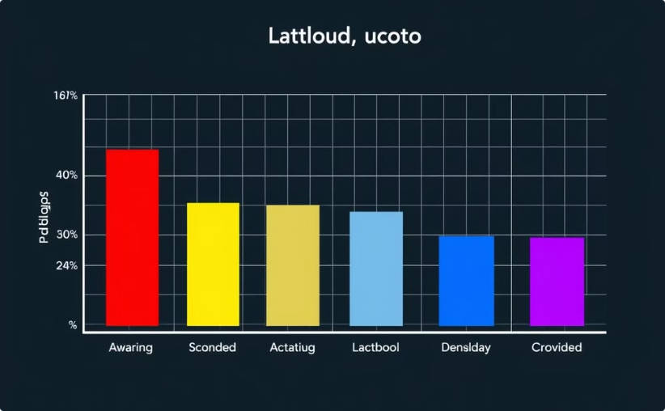
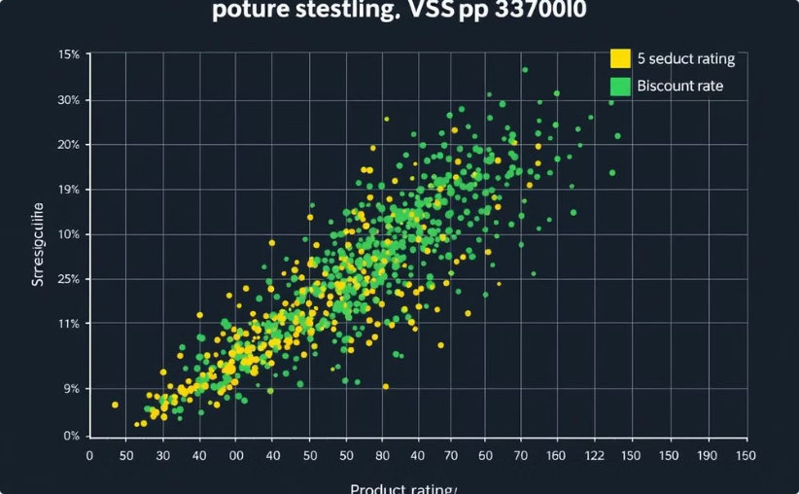
Filtering and Evaluation
Rating Distribution
Discount vs. Rating
Analyze the distribution of product ratings to understand customer sentiment.
Analyze the relationship between discount percentage and product rating.

Slide 10

Future Enhancements
1
Hybrid Approach
2
Personalization
3
Real-Time Updates
Combine collaborative and content-based filtering for more comprehensive recommendations.
Personalize recommendations based on user demographics, purchase history, and browsing behavior.
Update recommendations in real-time based on new user interactions and product availability.

